Slide 1
Endocrine disorders in Thalassaemia
Dr. Tahniyah Haq
Assistant Professor
Dept. of Endocrinology, BSMMU

Slide 2
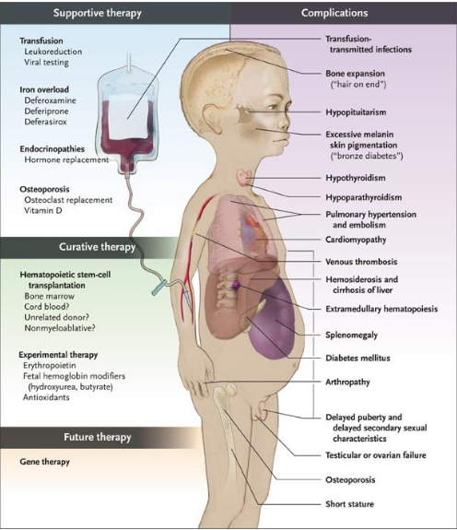
Endocrine complications are common in thalassaemia
More than 50 % have never been seen by an Endocrinologist

Slide 3
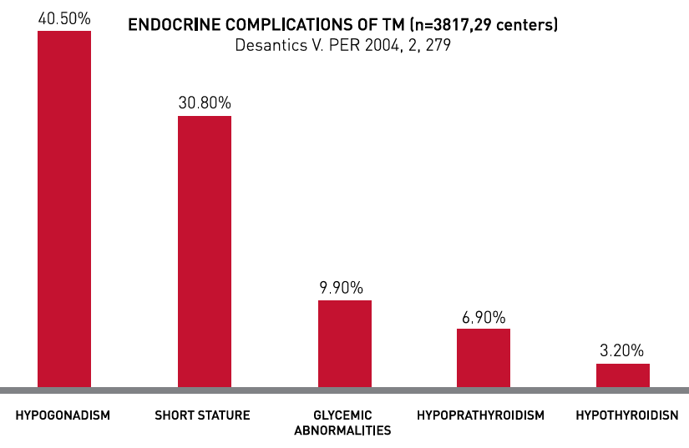
Delayed puberty and short stature are the most common

Slide 4
Delayed Puberty

Slide 5
Cause
Mainly iron overload
Both pituitary and gonadal failure

Slide 6
Clinical evaluation
Establishment of delayed puberty
absence or incomplete development of secondary sexual characteristics at
- 13 years for girls
- 14 years for boys
and/or
Failure to complete secondary sexual maturation
- within 5 years after onset of puberty

Slide 7
Secondary sex characteristics – Tanner stage
Girls – Breast development (B1-5)
pubic hair (P1-5)
Stage | Breast development
Stage 1 | preadolescent; elevation of papilla only
Stage 2 | breast bud stage. Onset of puberty
Stage 3 | further enlargement of the breast and areola, with no separation of their contours
Stage 4 | projection of the areola and papilla to form a secondary mound above the level of the breast
Stage 5 | mature stage; projection of the papilla only, recession of the areola

Slide 8
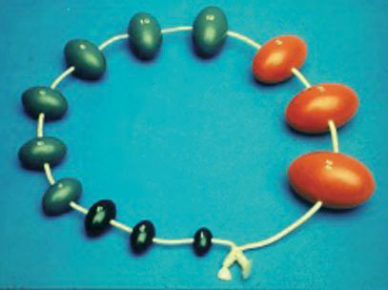
Boys - Testicular volume (TV), pubic hair (P1-5)
Stage | Event
Stage 1 | Prepubertal
Stage 2 | Enlargement of scrotum and testes (TV ≥ 4 ml), scrotum skin reddens and changes in texture
Stage 3 | Enlargement of penis (length at first), further enlargement of testes
Stage 4 | Enlargement of testes, scrotum, penis
Stage 5 | Adult genitalia (TV 15-25 ml)
15
Orchidometer
4

Slide 9
Investigations
CBC, LFT
FT4, TSH
X-ray left hand and wrist – bone age
DXA
Pituitary hormone tests
Pituitary MRI
 | Primary Hypogonadism | Secondary Hypogonadism
Oestrogen/Testosterone | Low | Low
LH, FSH | Elevated | Low / Normal

Slide 10
Short stature

Slide 11
Contributing factors include
anaemia
transfusional iron overload
chelation toxicity
nutritional deficiencies
growth hormone deficiency
hypogonadism, hypothyroidism, diabetes
psychosocial stress
chronic liver disease
increased energy expenditure due to high erythopoietic turnover and cardiac work
disturbed calcium homeostasis and bone disease

Slide 12
Clinical evaluation
Delayed growth becomes apparent from age 4 years
Establishment of short stature
- height below the 3rd centile for sex and age (based on national growth charts) and/or
- growth velocity < 5 cm/year or below 1SD for age and sex

Slide 13
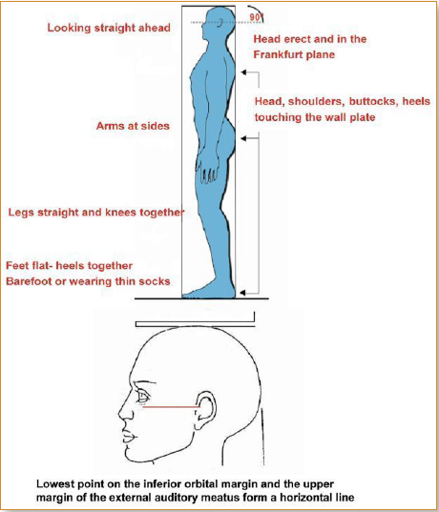
Measurement of height with stadiometer

Slide 14
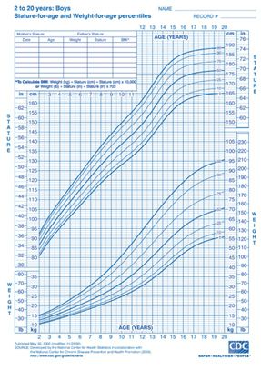
How to plot height and weight on a growth chart
Eg. A 6 year old boy with height 102 cm

Slide 15
Investigations
First line
Second line
CBC
FBS / OGTT
LFT
S. Ca, PO4
FT4, TSH
Urine RME
Bone age
CXR, Echo
GH stimulation test
IGF1
Pituitary hormones
Pituitary MRI
iPTH
25 (OH) Vit D

Slide 16
Treatment
Blood transfusion to maintain Hb > 9g/dl
Chelation to attain serum ferritin < 1000 ng/ml
Correction of nutritional deficiencies
GH treatment in patients with GHD
(higher dose, growth rate is slower)
Management of pubertal delay – sex hormones
Management of hypothyroidism and diabetes

Slide 17
Diabetes Mellitus

Slide 18
Common in inadequately iron chelated patients
Also in well transfused and regularly chelated patients

Slide 19
Diagnosis
Starts in the 2nd decade, increasing with age
Asymptomatic, symptomatic (polyuria, polydipsia, polyphagia, weakness, weight loss)
OGTT
Plasma glucose mmol/L | Fasting | After 75 gm glucose load
IFG | 6.1-6.9 | <7.8
IGT | <7 | 7.8-11
Diabetes | ≥ 7 | ≥ 11.1

Slide 20
Assessment and Treatment
Assess – SMBG, microvascular complications (fundus, sensory, Cr, ACR)
HbA1c - not a reliable indicator of glycaemia
(reduced red cell lifespan, ineffective haemopoiesis, frequent blood transfusions)
Treat – insulin, chelation

Slide 21
Hypoparathyroidism

Slide 22
Manifests in the 2nd decade of life
Investigations should begin from age 10 years
Special attention to cardiac complications

Slide 23
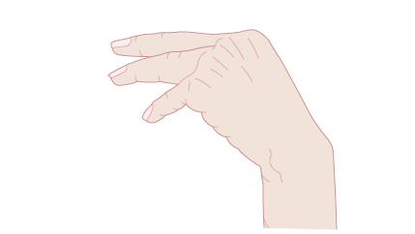
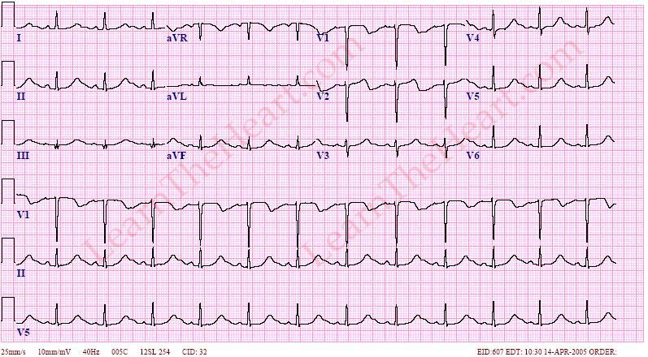
Evaluation and treatment
Tingling and numbness, latent tetany, seizures, prolong QT, refractory congestive heart failure
Calcium and vitamin D supplementation to maintain S. Ca 8.5-9 mg/dl
Trousseau signs

Slide 24
Hypothyroidism

Slide 25
Uncommon in optimally treated patients
Mainly attributed to iron overload
Central hypothyroidism is uncommon
Investigation should begin at the age of 9 years
It should be performed annually

Slide 26
Evaluation and treatment
Nonspecific symptoms (frequently attributed to anaemia), growth retardation (shorter with more delayed bone age), delayed puberty, decreased activity, reduced school performance, cardiac failure
Type of hypothyroidism | FT4 | TSH
Subclinical | Normal | Elevated 5-20 mIU/L
Primary | Low | Elevated > 20 mIU/L
Secondary | Low | Low, normal, slightly high < 20 mIU/L
Treat with thyroxine and adequate chelation

Slide 27
Adrenal insufficiency

Slide 28
Evaluation and treatment
Manifestations (asthenia, weight loss) masked by symptoms of thalassaemia
Adrenal crisis is rare
Short synacthen test – Cortisol < 550 nmol/L
Test adrenal function every 1-2 years
Treated with Hydrocortisone 15–20 mg daily
Special attention during stressful condition

Slide 29
Osteoporosis

Slide 30
Osteoporosis
BMD T-score <-2.5 assessed by DXA
Occurs in 40-50% cases
Contributing factors - genetic, hypogonadism, iron overload, bone marrow expansion, vitamin deficiencies and lack of physical activity
Annual checking of BMD starting in adolescence

Slide 31
Treatment
Diet rich in calcium
Physical activity
Calcium (500-1000 mg) and vitamin D (400IU)
Hormonal replacement when needed
Bisphosphonates
Early treatment of diabetes mellitus
Adequate iron chelation
Sufficient blood transfusions

Slide 32
NTDT

Slide 33
Screening - Start at 10 years of age
 | Test | Frequency
Growth retardation | Height , Bone age | 6 months
Hypogonadism | Tanner staging
Diabetes | FBS / OGTT | Annually
Hypothyroidism | FT4, TSH | Annually
Hypoparathyroidism | Ca, PO4, iPTH, VitD | Annually
Adrenal insufficiency | Synacthen | Annually
Osteoporosis | DXA | Annually

Slide 34
Thank You

